Slide 1




Unlocking Insights with Data Analytics
Data Analytics:
Predictive Models for defaulters and
Non-defaulters
Presented by: Vanessa Concillado

Slide 2



01
Objectives
Key Benefits of Data Analytics
Data analytics provides insights that lead to better-informed decisions in finance, allowing for strategic planning and risk management.
02
Problem Statement
Automation of data processing through analytics tools saves time and reduces errors, enabling finance teams to focus on strategic initiatives.
03
Steps in Analysis
Data analytics identifies cost-saving opportunities and inefficiencies, helping organizations optimize resources and improve their financial health.
04
Model Presentation
Data analytics identifies cost-saving opportunities and inefficiencies, helping organizations optimize resources and improve their financial health.
05
Recommendation
Data analytics identifies cost-saving opportunities and inefficiencies, helping organizations optimize resources and improve their financial health.

Slide 3



About Data Insights Analytics
We specialize in finance data analytics.
Our mission is to empower businesses with data-driven insights, enabling informed decision-making and enhanced financial performance.

Slide 4

STEP 1
STEP 2
Import Libraries and loading dataset
Data cleaning to ensure accuracy and reliability.
STEP 4
STEP 3
Data analysis using advanced analytical tools.
Data Visualization

Slide 5
STEP 2
Data cleaning to ensure accuracy and reliability.
Check for missing values
Check for class imbalance
Delete null values
Remove duplicates
Drop unnecessary columns not useful for prediction
Define features and target
Identify column types
Check class balance in your dataset. See if you have imbalanced data (important for model selection and evaluation).

Slide 6
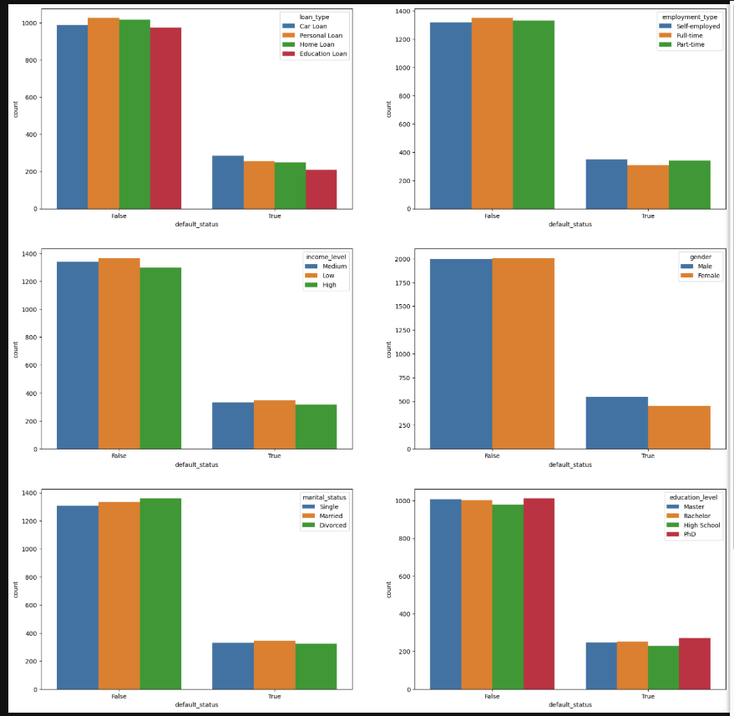
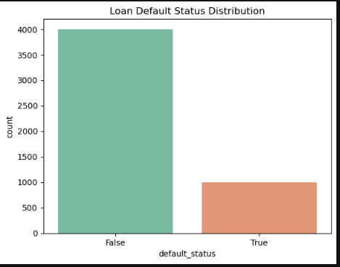
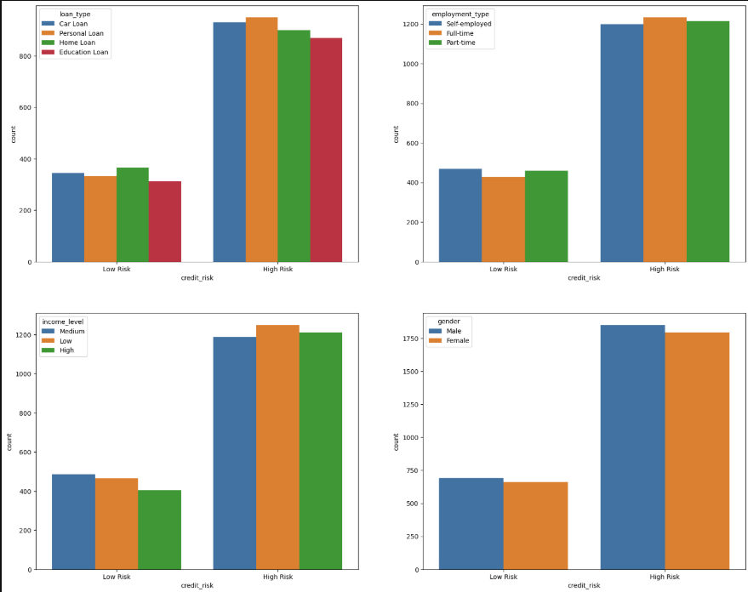
Default Status on other variables
STEP 3
Data Visualization
Loan Default Status Distribution
Credit Risk

Slide 7
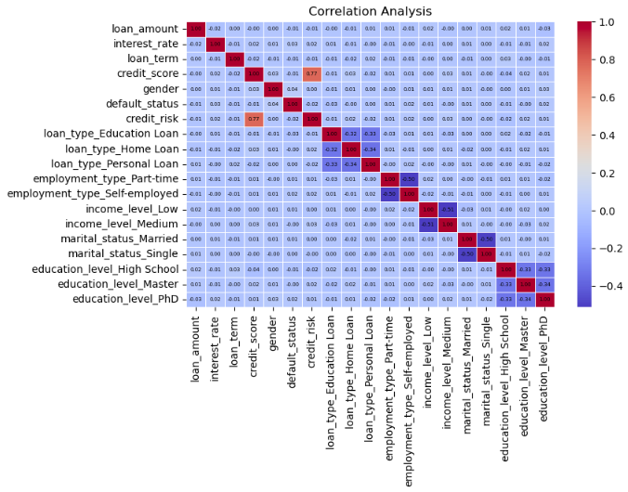
STEP 3
Data Visualization
Correlation Analysis

Slide 8
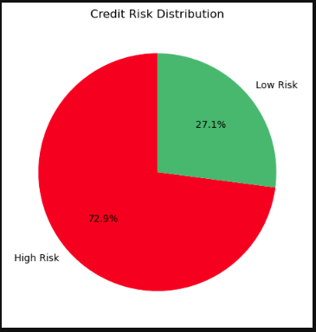
STEP 3
Data Visualization
Correlation Analysis

Slide 9
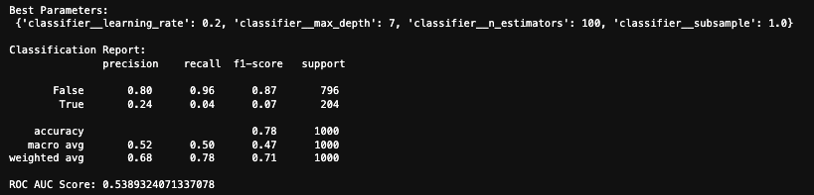
STEP 4
Data Analysis using Models
Split the data and Training the Model
GridSearchCV

Slide 10
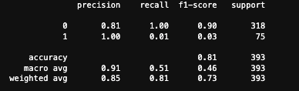
STEP 4
Data Analysis using Models
Split the data and Training the Model
Random Forest

Slide 11
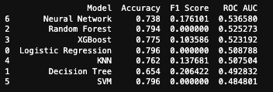
🔍 Detailed Interpretation
Logistic Regression / SVM
Accuracy: 0.796 – High, but both have F1 Score = 0.0, indicating very poor performance on minority class (e.g., defaulters). Likely predicts majority class only, leading to zero recall for the minority class.
Random Forest / XGBoost(designed for structured/tabular data.High accuracy(Handles non-linear patterns, Robust to overfitting (with tuning)
Accuracy: 0.794 / 0.775 – Still decent. F1 Score: 0.0 / 0.10 – Slightly better for XGBoost, but still weak. Better ROC AUC (~0.52) – Slight improvement in probability-based classification.
Decision Tree
Lowest Accuracy (0.654), but highest F1 Score (0.206) – this model captures minority class better, though at the cost of accuracy. May be better if your goal is recall on defaulters.
K-Nearest Neighbors (KNN)
Balanced profile – decent F1 (0.137) and ROC AUC (0.507), but not the best in any category. May benefit from tuning- might perform better if you adjust its hyperparameters
Neural Network
Lowest Accuracy (0.738) but best ROC AUC (0.537) and a modest F1 (0.176) – indicates it's better at scoring class probabilities, even if it misclassifies more overall.
STEP 4
Data Analysis using Models
All Models

Slide 12
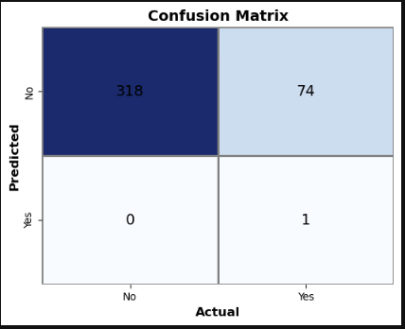
STEP 4
Data Analysis using Models
Logistic Regression
Confusion Matrix

Slide 13
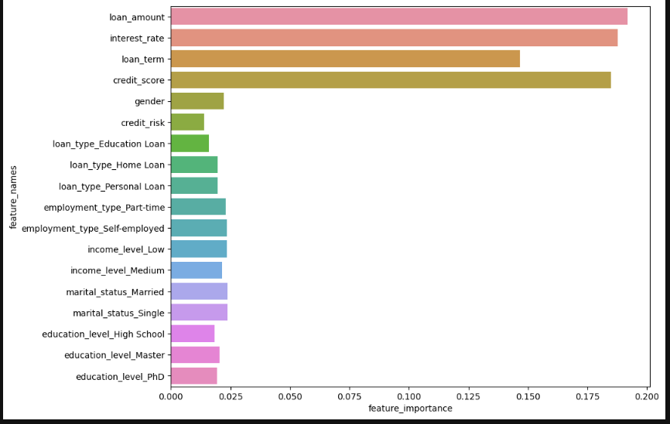
STEP 4
The longer the bar, the more important the feature is to the model's decision-making process.
The x-axis shows the relative importance score (typically normalized to sum to 1).
🔍 Top Insights: Most Important Features: loan_amount, interest_rate, loan_term, and credit_score are the top 4 most influential features.
This means the model relies heavily on the financial characteristics of the loan when predicting default risk.
Moderate Impact:
gender, loan_type, and employment_type have a moderate influence, meaning demographic and loan category information has some predictive power.
Less Impactful Features:
income_level, marital_status, education_level, and credit_risk have minimal effect on the model’s predictions.
These may still contribute but are not as critical.
📊 Business Implications: Borrowers with higher loan amounts, high-interest rates, and longer loan terms are more likely to influence the model’s prediction of default.
Credit score is a strong predictor — reinforcing its real-world relevance in credit risk modeling.
Sociodemographic variables (e.g., education, marital status) play a smaller role in this dataset, suggesting your model is mainly driven by financial behavior.
Data Analysis using Models
Ploting features Importance

Slide 14


“Data-driven decisions are essential for achieving financial success.”
– John Doe, CFO of Financial Insights

